Slide 1
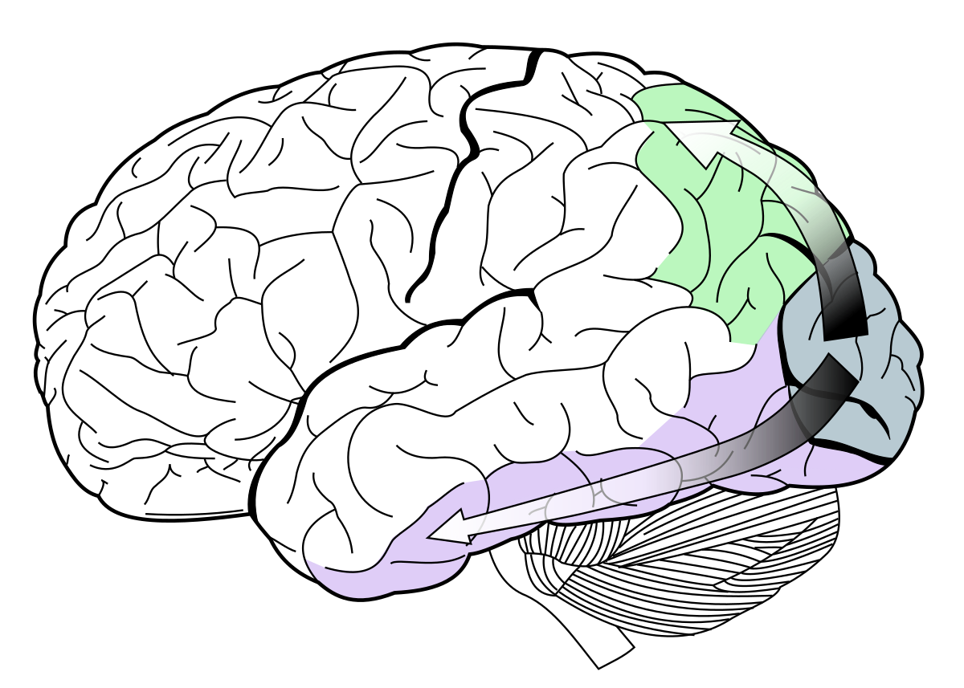
The Two-Stream Hypothesis as a Foundation for Human-like Memory and Action
BICA 2025 Puerto Vallarta, Mexico
Howard Schneider
Sheppard Clinic North, Vaughan, Ontario, Canada
hschneidermd@alum.mit.edu

Slide 2

Introduction
- The two-stream hypothesis in neuroscience posits separate visual pathways:
- Dorsal stream: "where/how" (spatial/motor guidance)
- Ventral stream: "what" (object identity)
- Similar dorsal/ventral separation seen in auditory pathways
- Found in all mammals
- Question: Is this division a biological artifact or a functional advantage?

Slide 3
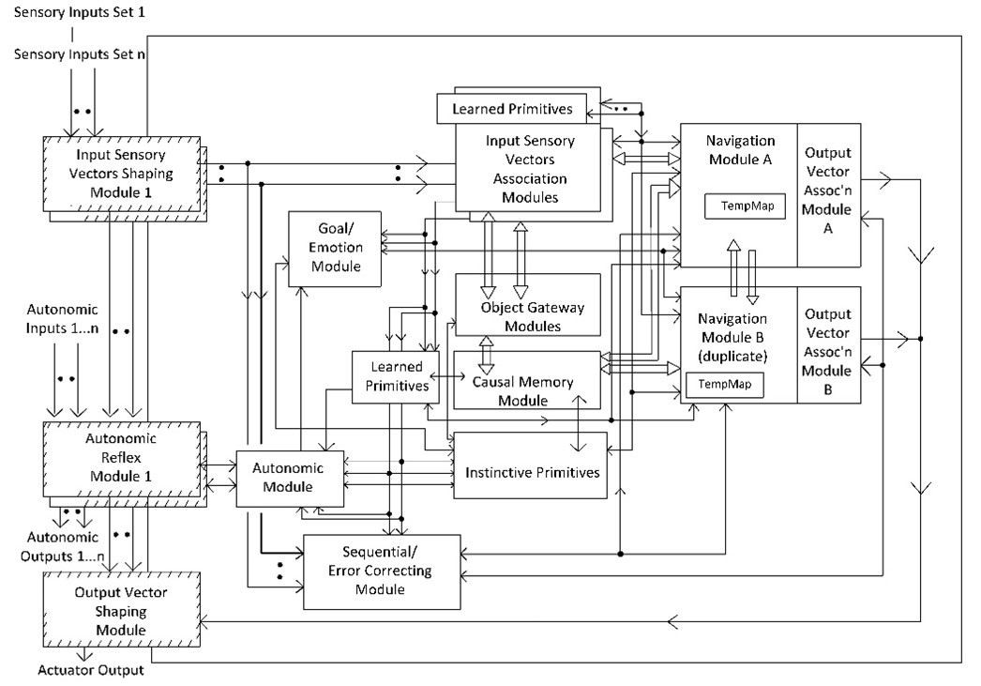
More efficient to hold ‘what’ and ‘where/how’ information in one location? Or advantage to splitting the information?

Slide 4
More efficient to hold ‘what’ and ‘where/how’ information in one location? → relevant to cognitive architecture design

Slide 5
Related work
ACT-R cognitive architecture -> ACT-R/PM with “visual-location” and “visual-object”, but model trade-offs are unclear
Work by Mishkin et al. (macaque lesions), Goodale and Milner (humans)

Slide 6
approach
An advantage of splitting identification circuits (“what”) and spatial guidance circuits (“where/how”) is to parallelize and specialize resource usage
A disadvantage of the dorsal/ventral split is the need to integrate information

Slide 7
approach
We create and evaluate a simulation model of a “split-store” model (i.e., “what” and “where/how” circuits separate)
versus
a “unified store” model (i.e., “what” and “where/how” data in same location)

Slide 8
approach
- Unified store: both object and spatial data in one location (e.g., CCA7 architecture)
- Split store: separate circuits for object identification and spatial localization (e.g., brain)
- Hypothesis: separation may enable specialization and parallel processing
- Key question: does this separation provide performance benefits in the brain? In cognitive architectures?

Slide 9
methods
- Python-based simulation (Python 3.11.4)
- Environment:
- 100 million position 2D grid
- 5000 unique objects with random features
- Workload: 10,000 queries per condition
- Canonical (i.e., default) workload: 40% "what", 40% "where", 20% integrated
- Code available: https://github.com/howard8888/bica25/blob/main/two_stream_ver01.pyj

Slide 10
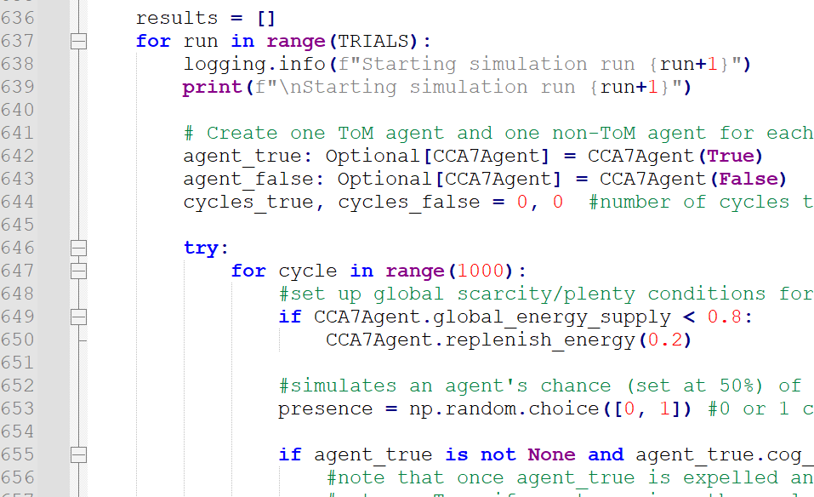

Slide 11
Comparison Models
- Unified model: one structure for both object and spatial data
- Split model: two structures, one for "what" and one for "where/how"
→ Each model evaluated on identical queries and object distributions

Slide 12
results
Baseline timings for canonical workload (40%/40%/20%)
Parameter-sweeps:
2A. Sweep (i.e., vary) composition (Block A)
2B. Sweep number of objects (Block B)
2C. Sweep the amount of parallelism (Block C)

Slide 13
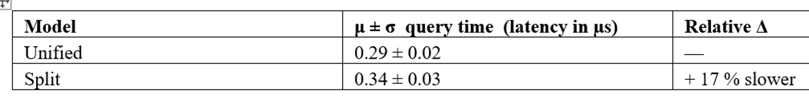
1. query times on a canonical 40% where/40% what /20% integrated mix of 10,000 queries for the unified vs split

Slide 14
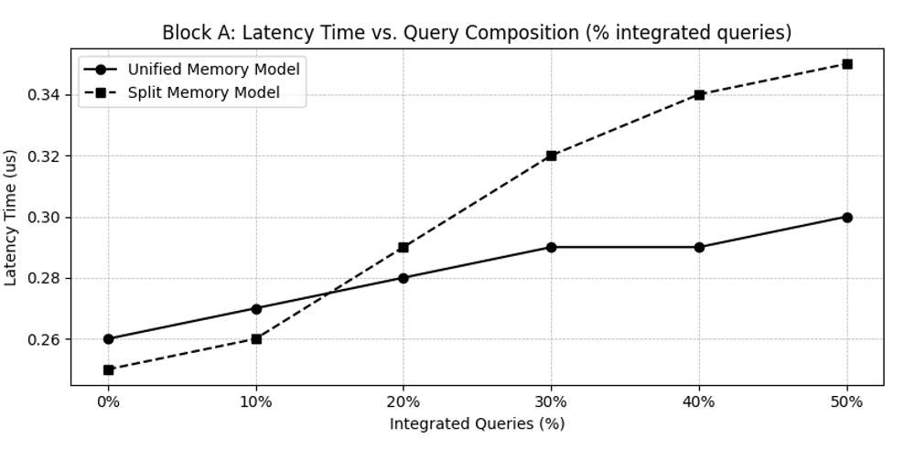
2A. Time vs %integrated queries
- Unified model faster with more integrated queries
- Split model outperforms with more non-integrated queries
- Integration overhead is costly in split model

Slide 15
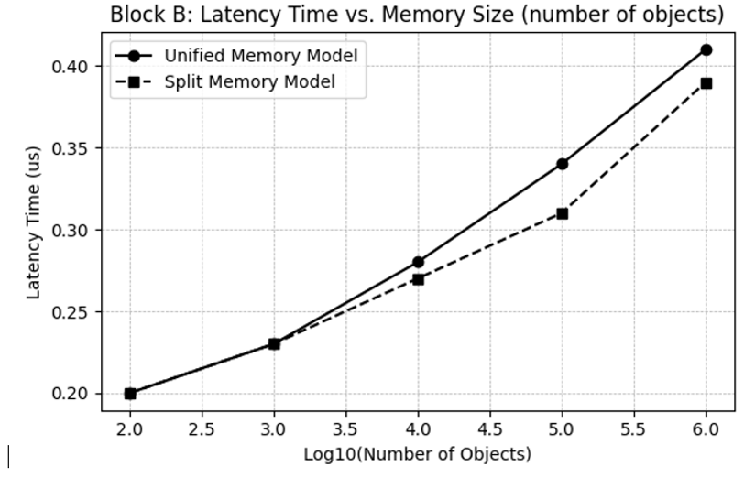
2B. Time vs number of objects
- Increasing object count slows unified model significantly
- Split model shows better scalability with object count

Slide 16
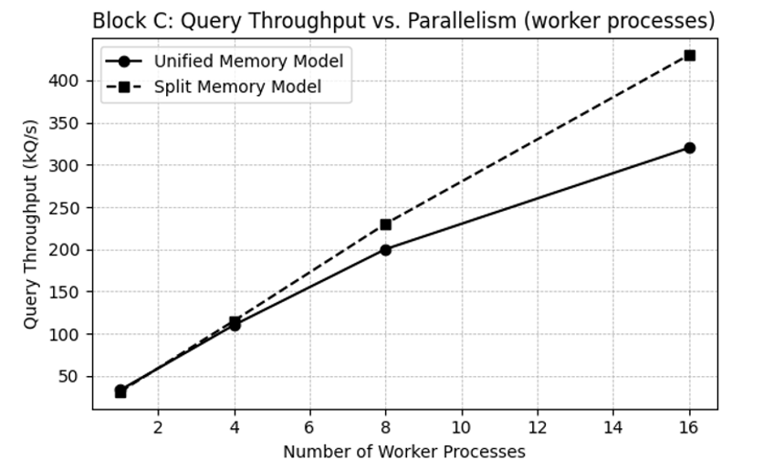
2C. Throughput vs. parallelism
- Parallelism reduces latency in split model
- Unified model less able to benefit from parallel query processing
- Split model becomes faster with high parallelism

Slide 17
Results summary
The unified model was faster when there were substantial number of integrated queries, although for higher % routine non-integrated queries, the split-model was faster
For larger number of objects in the envr’t, the unified model slows down slightly
With more parallel processing, the split- model was faster

Slide 18
discussion
From a brain evolutionary approach, having different “what” and “where/how” circuits allows each to become more specialized – “where/how” needs a fast visuomotor loop while “what” needs more richly structured data

Slide 19
Simulation shows -- with massive parallelism, as exists in the brain, the split-model is no longer slow compared to the unified model

Slide 20
From a cognitive point of view, the misalignment between “what” and “where” memories forces the brain to perform binding operations, possibly allowing compositional and creative results to emerge
Future work

Slide 21
The dorsal-ventral (“where/how”-”what”) pathways are not just a biological artifact, but a viable design principle for future brain-inspired cognitive architectures (BICAs)
Future work

Slide 22

Thank you
hschneidermd@alum.mit.edu

